Slide 1
GENERATIVE AI & CONVERSATIONAL AI
ThangarajAI Chatbot
AI-powered learning platform with hybrid FAQ retrieval and Gemini fallback.
github.com/tmthangaraj1980-AIML/AI-PROJECTS/ThangarajAI_Chatbot

Slide 2

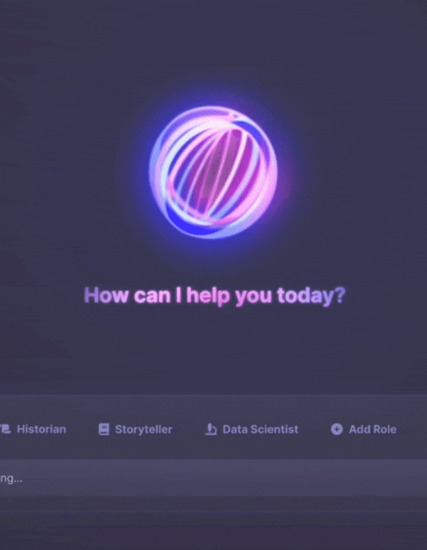
THE PROBLEM
Interview Prep Friction
Scattered Knowledge: AI/ML concepts are fragmented across documentation.
Slow Retrieval: Searching manuals wastes valuable study time.
Static Repositories: Pre-written FAQs fail on unmapped edge queries.

Slide 3



Core Capabilities
Curated Knowledge
Intelligent Matching
Gemini Fallback
500+ AI/ML interview questions natively mapped.
Similarity thresholds matching user intent to FAQs.
Real-time generative generation for unknown queries.

Slide 4






Technology Stack
Python
Streamlit
Pandas
Difflib
Gemini 2.5
Flash
Transformers

Slide 5
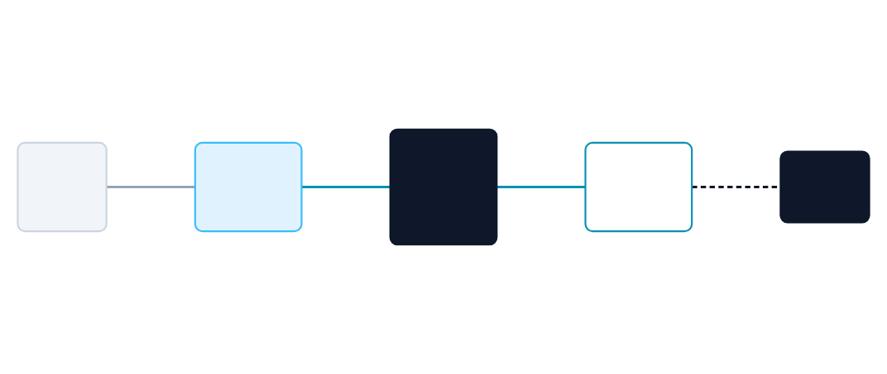
Application Architecture
User
Question
Response
Streamlit UI
Difflib
FAQ CSV /
(Session State)
(Similarity Search)
Gemini API

Slide 6
Inference Workflow
1. Clean
2. Match
3. Route
4. Render
Strip bullets and lowercase query.
Evaluate string similarity cutoff.
Query Dataset or call Gemini.
Streamlit chat output generation.

Slide 7
Domains & Data Pipeline
Knowledge Domains
Dataset Mechanics
Python & Data Science.
500+ curated FAQ rows loaded via Pandas.
Machine Learning & NLP.
Lowercase structural normalization mapping.
Deep Learning & Generative AI.
O(1) exact match lookup prioritization.

Slide 8
Hybrid Retrieval Engine
String Similarity Lookup
Generative Fallback
Difflib SequenceMatcher
Gemini 2.5 Flash API
Evaluates string similarity with a strict 0.75+ cutoff threshold to guarantee high-accuracy local dataset retrieval.
Handles out-of-scope questions by generating dynamic responses securely via environment-injected API keys.

Slide 9
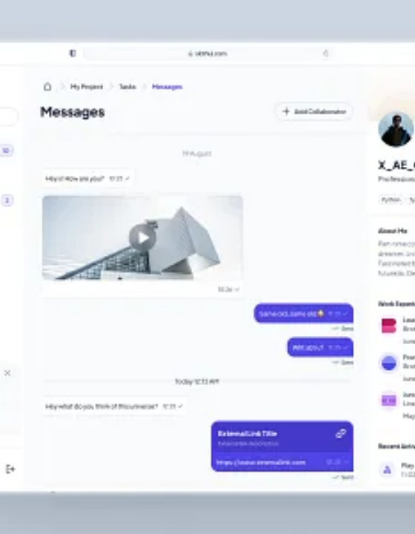
User Interface
Interactive learning dashboard built completely in Streamlit using conversational UI elements.
Streamlit chat_input element.
Dataset metrics header display.
Topic outline sidebar.

Slide 10
Future Roadmap
Enhanced Interactions
Advanced Integrations
Voice Input: Expanding accessibility for learners.
RAG Architecture: Integration of full PDF knowledge bases.
AI Mock Interviews: Simulating real-time pressure tests.
Resume Parsing: Tailoring interview questions to specific CVs.

Slide 11
Technical Q&A
1. Why use Difflib over Vector Search?
4. How are user inputs normalized?
Lightweight, zero-latency string matching ideal for exact interview FAQ lookups.
Bullet points and hyphens are stripped, and text is lowercased prior to dictionary lookup.
2. How is the fallback triggered?
5. Security approach for Gemini API?
If the get_close_matches similarity score falls below 0.75, the query routes to Gemini.
Loaded securely via os.getenv() to prevent hardcoding keys in public GitHub repositories.
3. State management in Streamlit?
Session_state explicitly preserves the current_question and current_response across UI renders.

Slide 12

ThangarajAI - Knowledge Hub
Bridging the gap between static dataset retrieval and generative intelligence.
/AI-PROJECTS/ThangarajAI_Chatbot
tmthangaraj1980

Slide 13


Image Sources
https://files.smashing.media/articles/designing-ai-beyond-conversational-interfaces/9-abstraction-rolebot.gif
Source: www.smashingmagazine.com
https://cdn.dribbble.com/userupload/15008698/file/original-59cd89b153b55320f0c8719207ce5c31.jpg?format=webp&resize=400x300&vertical=center
Source: dribbble.com

